Slide 1
Lecture 4: Lagrange interpolation splines & root finding
Omer Bromberg
omerbr@tauex.tau.ac.il
Winter 2025/6
Modified from lecture notes by Cyrus Dreyer & Michael Zingale

Slide 2
Interpolation (see Pang Ch. 2)
Needed when we want to infer information from a set of incomplete or discrete data.
E.g., experimental data or data from computational simulations
Different types of interpolation based on assumptions and requirements for the data
Some ensure no new extrema are introduced
Some match derivatives at end points
Need to balance number of points used against pathologies (e.g., oscillations)
Interpolations and fitting are different!
Interpolation seeks to fill in missing information in some small region of the whole dataset
Fitting a function to the data seeks to produce a model (guided by physical intuition) so you can learn more about the global behavior of your data
Notes:
Interpolation is a local procedure fitting is a global procedure.

Slide 3
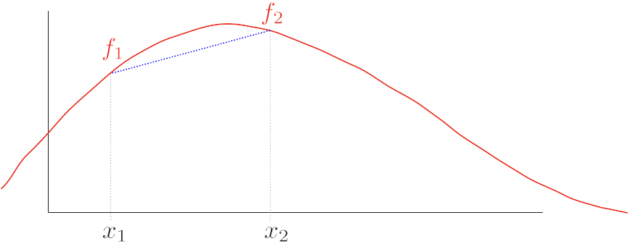
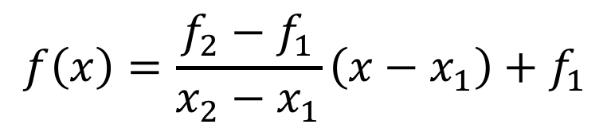
Linear interpolation: Draw a line between two points
$$f\left(x\right)=\frac{f_{2}−f_{1}}{x_{2}−x_{1}}\left(x−x_{1}\right)+f_{1}$$

Slide 4
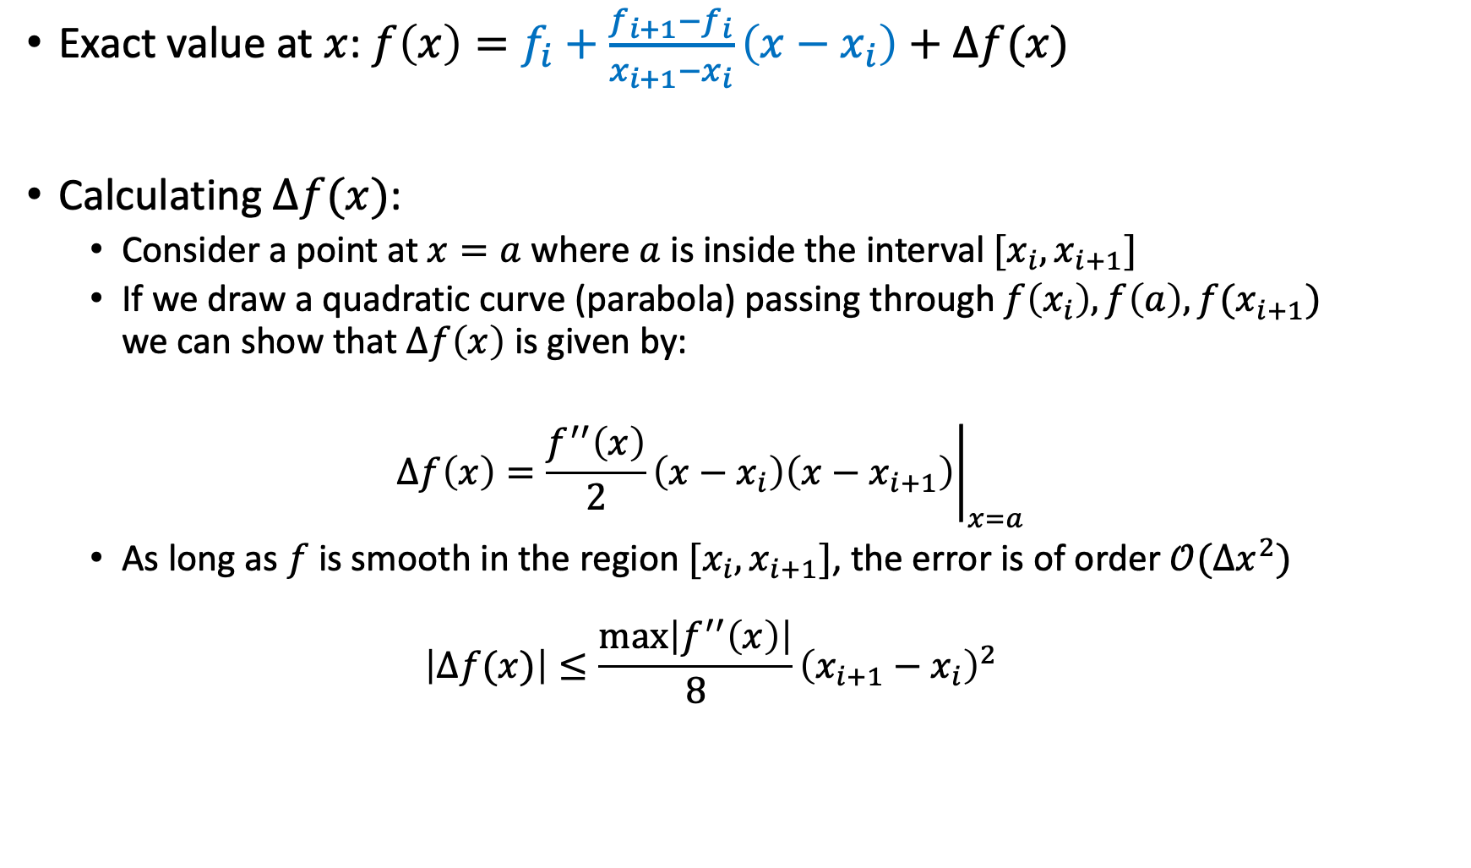
Errors in linear interpolation
Exact value at $x$: $f\left(x\right)=f_{i}+\frac{f_{i+1}−f_{i}}{x_{i+1}−x_{i}}\left(x−x_{i}\right)+Δf(x)$
Calculating $Δf(x)$:
Consider a point at $x=a$ where $a$ is inside the interval $[x_{i},x_{i+1}]$
If we draw a quadratic curve (parabola) passing through $f\left(x_{i}\right),f\left(a\right), f(x_{i+1})$ we can show that $Δf\left(x\right)$ is given by:
$$Δf\left(x\right)={\left.\frac{f^{′′}\left(x\right)}{2}\left(x−x_{i}\right)\left(x−x_{i+1}\right)\right|}_{x=a}$$
As long as $f$ is smooth in the region $[x_{i},x_{i+1}]$, the error is of order $𝒪(Δx^{2})$
$$\left|Δf(x)\right|≤\frac{\max\left|f^{′′}\left(x\right)\right|}{8}{\left(x_{i+1}−x_{i}\right)}^{2}$$
Linear interpolation
Error

Slide 5
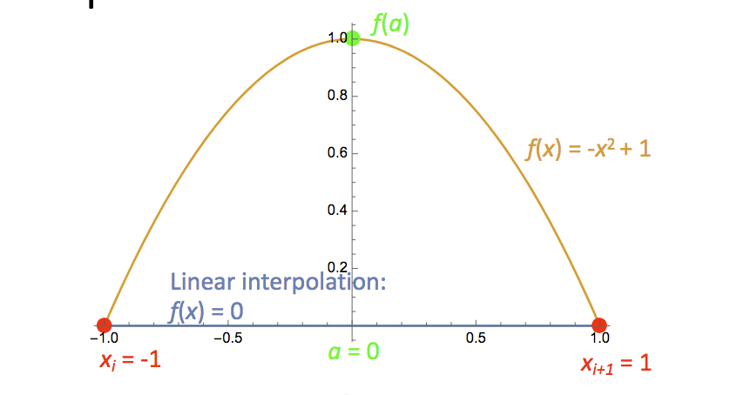
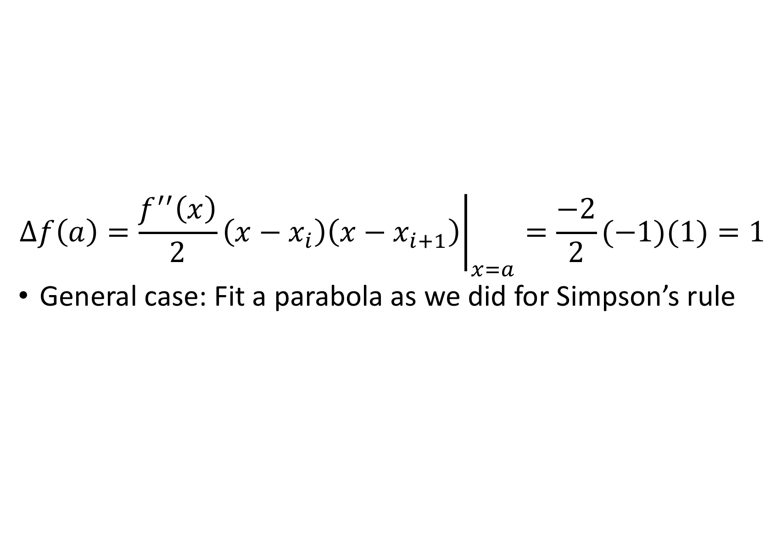
Simple example of errors in linear interpolation:
$$Δf\left(a\right)={\left.\frac{f^{′′}\left(x\right)}{2}\left(x−x_{i}\right)\left(x−x_{i+1}\right)\right|}_{x=a}=\frac{−2}{2}(−1)(1)=1$$
General case: Fit a parabola as we did for Simpson’s rule
Notes:
Like the error in the trapezoid method (make sense).

Slide 6
General approach for interpolation schemes
Continuous curve is constructed from given discrete set of data
Interpolated value is read off the curve
The more points, the higher order the curve can be
One way to achieve higher-order interpolation is through Lagrange interpolation

Slide 7
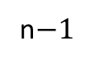
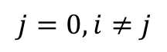
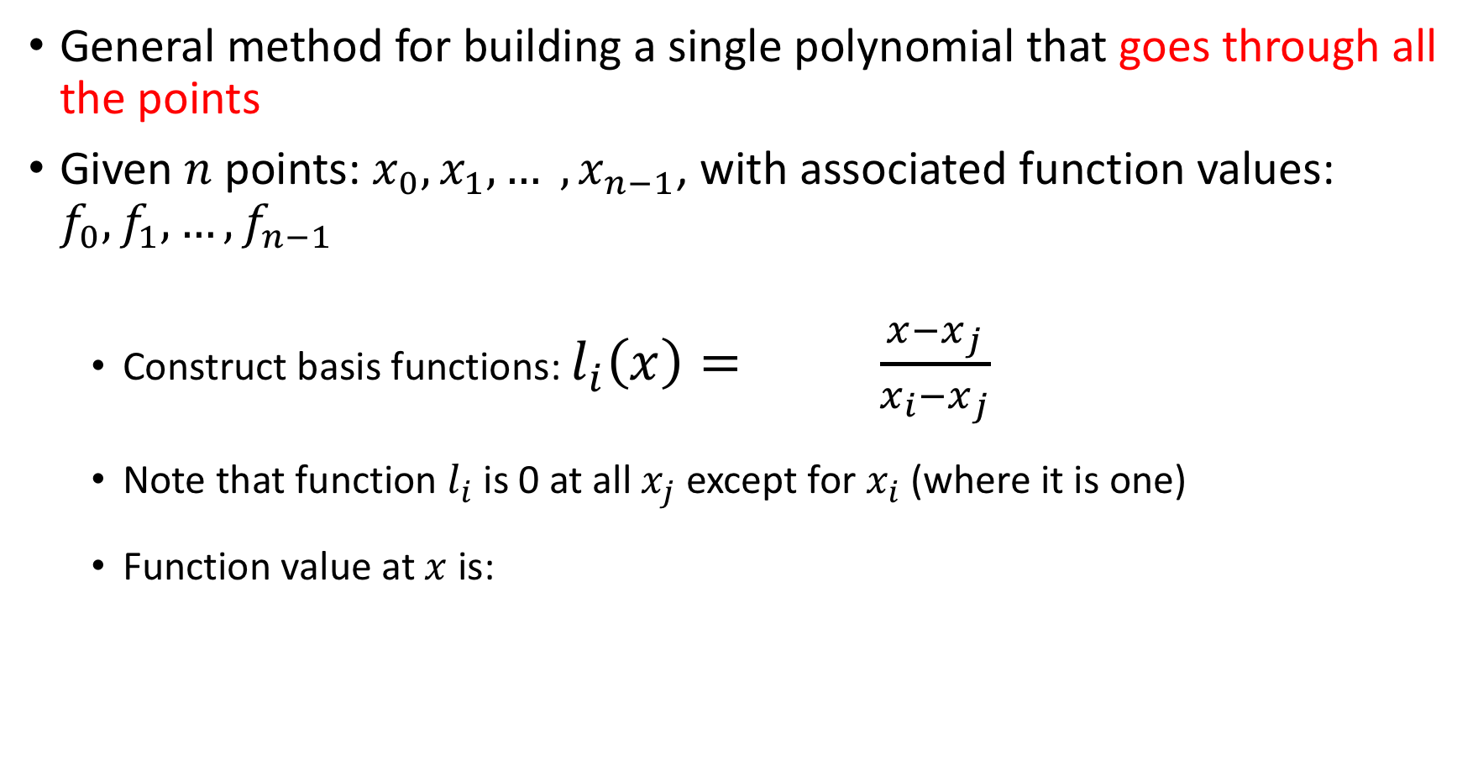

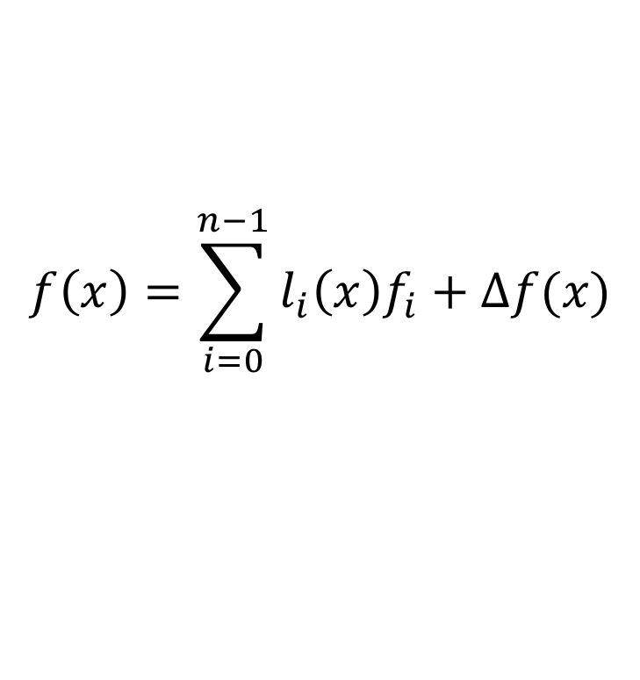
Lagrange interpolation
General method for building a single polynomial that goes through all the points
Given $n$ points: $x_{0}, x_{1}, … , x_{n−1}$, with associated function values: $f_{0}, f_{1}, …, f_{n−1}$
Construct basis functions: $l_{i}\left(x\right)= \frac{x−x_{j}}{x_{i}−x_{j}}$
Note that function $l_{i}$ is 0 at all $x_{j}$ except for $x_{i}$ (where it is one)
Function value at $x$ is:
n$−1$
$$Π$$
$$j=0, i≠j$$
$$f\left(x\right)=\sum_{i=0}^{n−1}{l_{i}\left(x\right)f_{i}}+Δf(x)$$

Slide 8
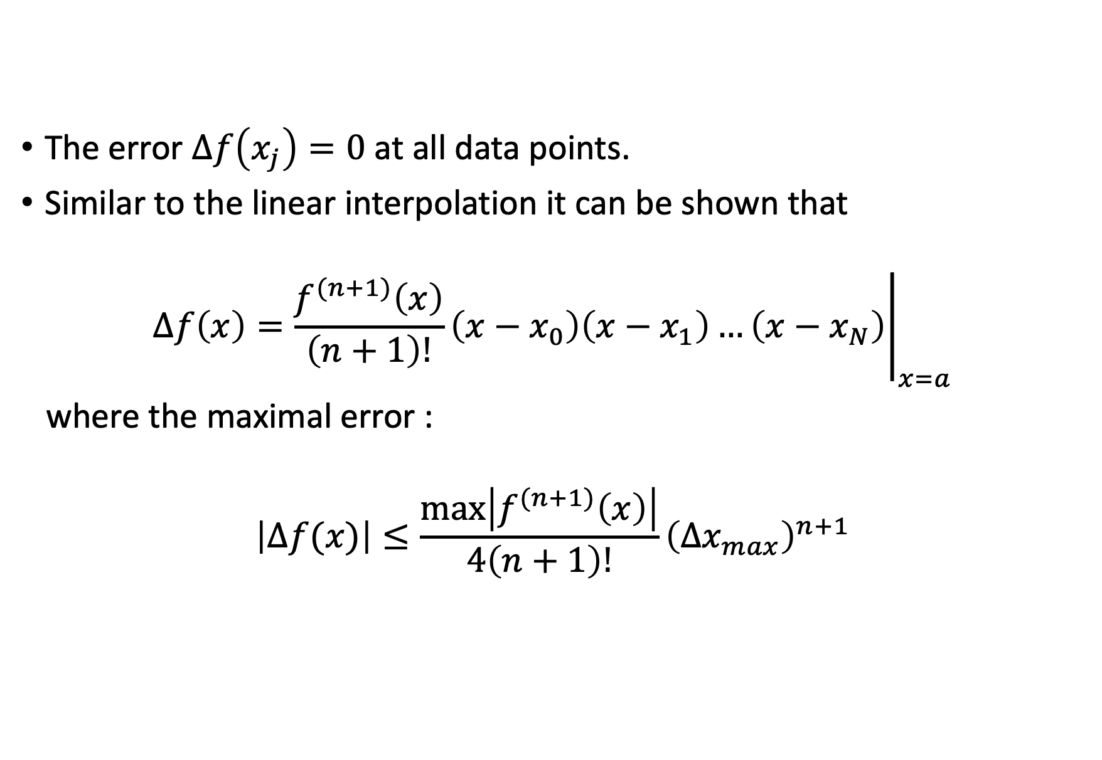
Lagrange interpolation error
The error $Δf\left(x_{j}\right)=0$ at all data points.
Similar to the linear interpolation it can be shown that
$$Δf\left(x\right)={\left.\frac{f^{(n+1)}\left(x\right)}{\left(n+1\right)!}\left(x−x_{0}\right)\left(x−x_{1}\right)…\left(x−x_{N}\right)\right|}_{x=a}$$
where the maximal error :
$$\left|Δf(x)\right|≤\frac{\max\left|f^{(n+1)}\left(x\right)\right|}{4\left(n+1\right)!}{\left(Δx_{max}\right)}^{n+1}$$

Slide 9
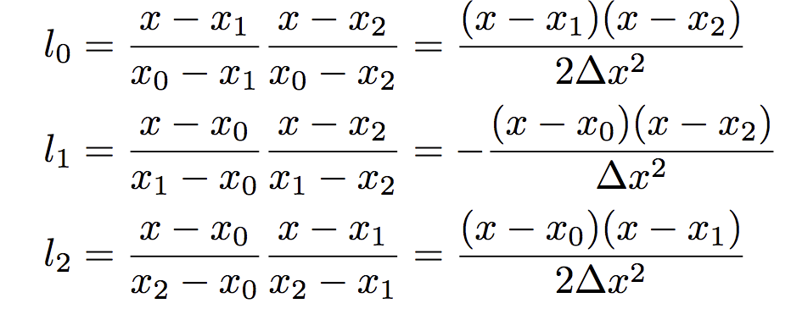
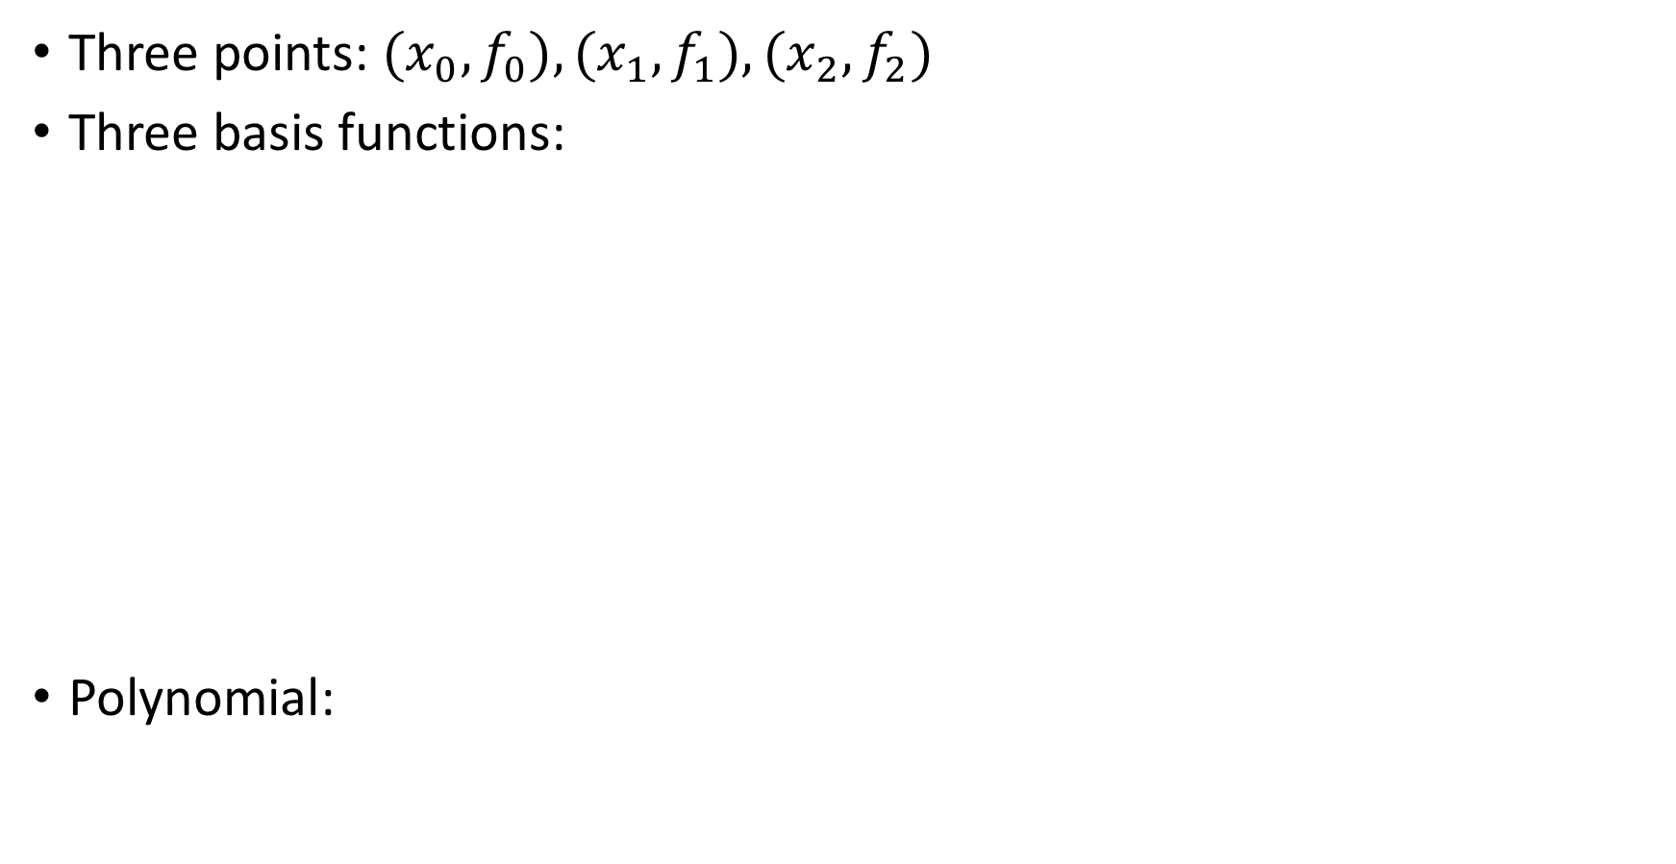
Example: Quadratic Lagrange polynomial
Three points: $(x_{0},f_{0}), (x_{1},f_{1}), (x_{2},f_{2})$
Three basis functions:
Polynomial:

Slide 10
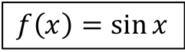
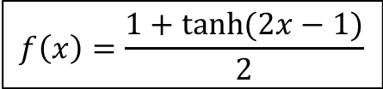
Example: Lagrange Interpolation of two functions
$$f\left(x\right)=\frac{1+tanh{(2x−1)}}{2}$$
$$f\left(x\right)=\sin{x}$$

Slide 11
Example: Lagrange Interpolation of two functions
$$f\left(x\right)=\frac{1+tanh{(2x−1)}}{2}$$
$$f\left(x\right)=\sin{x}$$

Slide 12
Example: Lagrange Interpolation of two functions
$$f\left(x\right)=\frac{1+tanh{(2x−1)}}{2}$$
$$f\left(x\right)=\sin{x}$$

Slide 13
Example: Lagrange Interpolation of two functions
$$f\left(x\right)=\frac{1+tanh{(2x−1)}}{2}$$
$$f\left(x\right)=\sin{x}$$

Slide 14
Example: Lagrange Interpolation of two functions
$$f\left(x\right)=\frac{1+tanh{(2x−1)}}{2}$$
$$f\left(x\right)=\sin{x}$$
Notes:
Runge phenomena

Slide 15
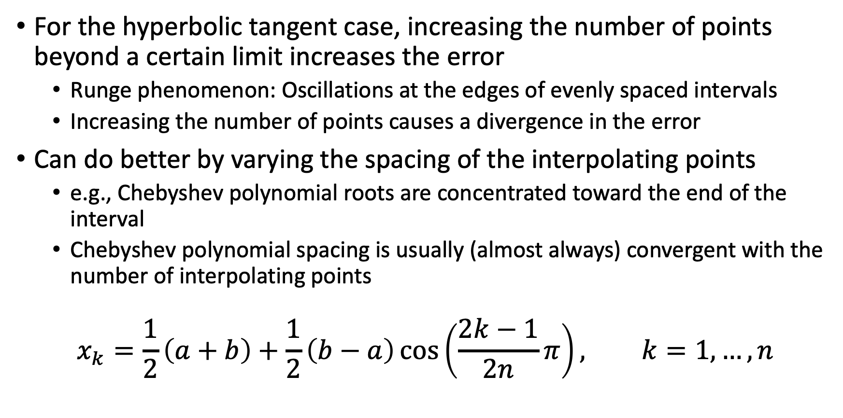
Example: Lagrange Interpolation of two functions
For the hyperbolic tangent case, increasing the number of points beyond a certain limit increases the error
Runge phenomenon: Oscillations at the edges of evenly spaced intervals
Increasing the number of points causes a divergence in the error
Can do better by varying the spacing of the interpolating points
e.g., Chebyshev polynomial roots are concentrated toward the end of the interval
Chebyshev polynomial spacing is usually (almost always) convergent with the number of interpolating points
$$x_{k}=\frac{1}{2}\left(a+b\right)+\frac{1}{2}\left(b−a\right)\cos\left(\frac{2k−1}{2n}π\right), k=1,…,n$$
Notes:
The Runge phenomenon is caused by using a high-degree polynomial to interpolate a function with equally spaced data points

Slide 16
Example: Lagrange Interpolation of two functions with Chebyshev nodes
$$f\left(x\right)=\frac{1+tanh{(2x−1)}}{2}$$
$$f\left(x\right)=\sin{x}$$

Slide 17
Example: Lagrange Interpolation of two functions with Chebyshev nodes
$$f\left(x\right)=\frac{1+tanh{(2x−1)}}{2}$$
$$f\left(x\right)=\sin{x}$$

Slide 18
Example: Lagrange Interpolation of two functions with Chebyshev nodes
$$f\left(x\right)=\frac{1+tanh{(2x−1)}}{2}$$
$$f\left(x\right)=\sin{x}$$

Slide 19
Example: Lagrange Interpolation of two functions with Chebyshev nodes
$$f\left(x\right)=\frac{1+tanh{(2x−1)}}{2}$$
$$f\left(x\right)=\sin{x}$$

Slide 20
Example: Lagrange Interpolation of two functions with Chebyshev nodes
$$f\left(x\right)=\frac{1+tanh{(2x−1)}}{2}$$
$$f\left(x\right)=\sin{x}$$

Slide 21
Example: Lagrange Interpolation of two functions with Chebyshev nodes
$$f\left(x\right)=\frac{1+tanh{(2x−1)}}{2}$$
$$f\left(x\right)=\sin{x}$$

Slide 22
After class tasks
• Homework and instructions for turning it in will be posted later today
Readings:
Newman Chapter 5
Garcia Section 10.2
Pang Section 2.1
Wikipedia article on Chebyshev nodes
Myths about polynomial interpolation

Slide 23
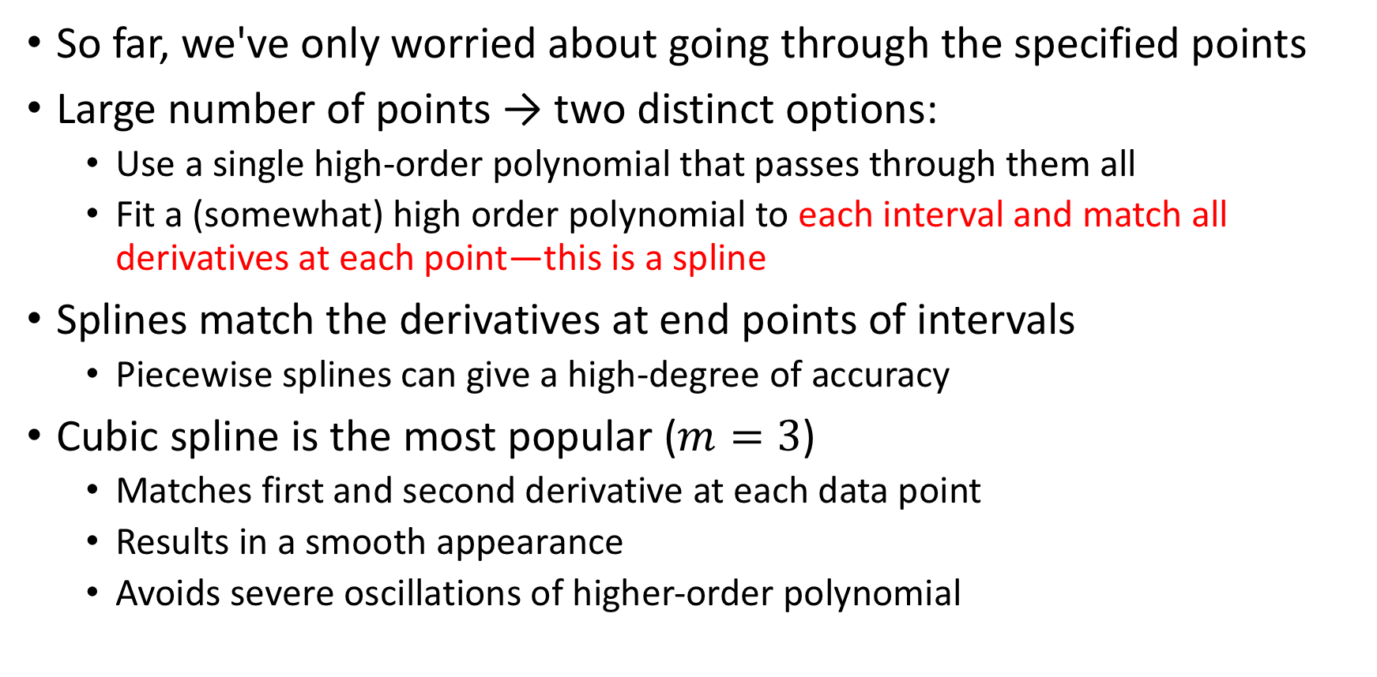
Splines (Pang Sec. 2.4)
So far, we've only worried about going through the specified points
Large number of points → two distinct options:
Use a single high-order polynomial that passes through them all
Fit a (somewhat) high order polynomial to each interval and match all derivatives at each point—this is a spline
Splines match the derivatives at end points of intervals
Piecewise splines can give a high-degree of accuracy
Cubic spline is the most popular ($m=3$)
Matches first and second derivative at each data point
Results in a smooth appearance
Avoids severe oscillations of higher-order polynomial
Notes:
Instead of fitting the whole sets of points with a single polynomial, we fit sub-sets with separate polinomials and connect them smothely

Slide 24
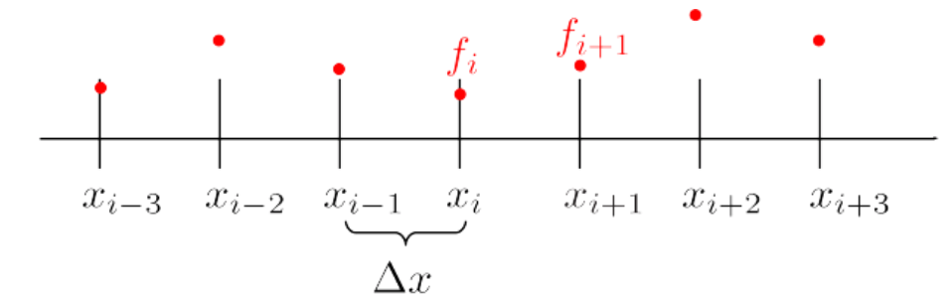
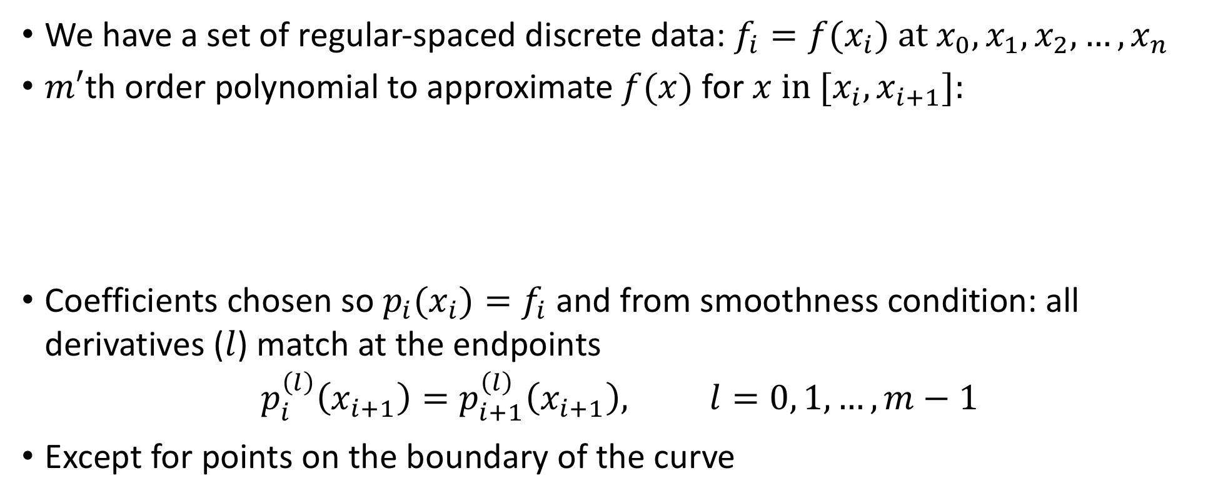
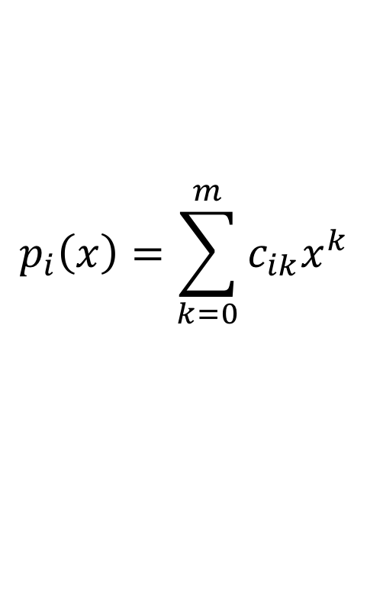
Splines
We have a set of regular-spaced discrete data: $f_{i}=f(x_{i}) at x_{0},x_{1},x_{2},…,x_{n}$
$m′$th order polynomial to approximate $f(x)$ for $x in [x_{i},x_{i+1}]:$
Coefficients chosen so $p_{i}(x_{i})=f_{i}$and from smoothness condition: all derivatives ($l$) match at the endpoints
$$p_{i}^{\left(l\right)}\left(x_{i+1}\right)=p_{i+1}^{\left(l\right)}\left(x_{i+1}\right), l=0, 1,…,m−1$$
Except for points on the boundary of the curve
$$p_{i}\left(x\right)=\sum_{k=0}^{m}{c_{ik}x^{k}}$$

Slide 25
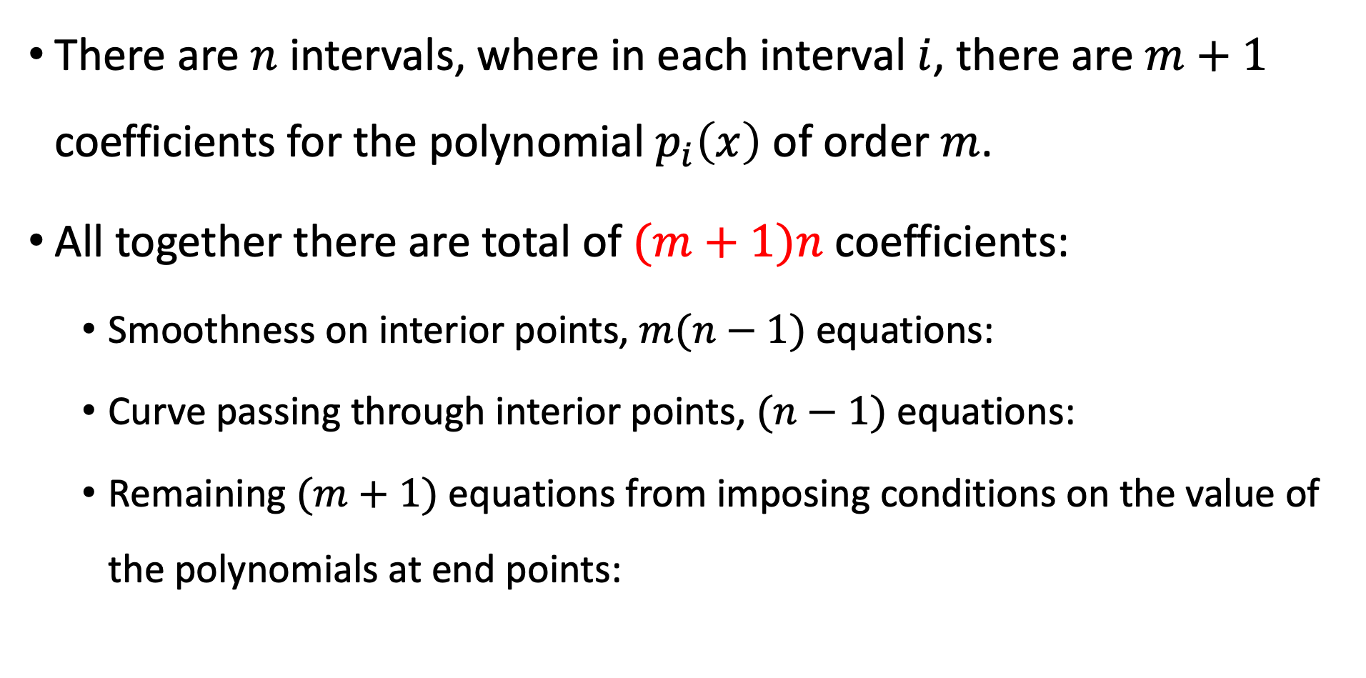
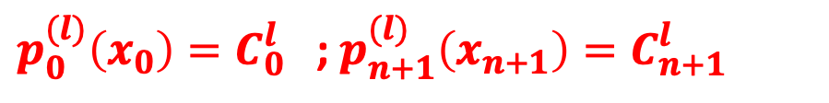
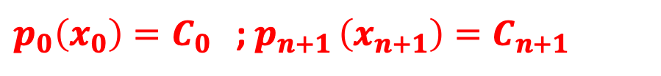

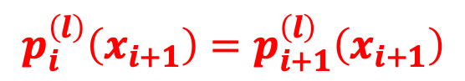
Splines: Determining the coefficients
There are $n$ intervals, where in each interval $i$, there are $m+1$ coefficients for the polynomial $p_{i}\left(x\right)$ of order $m$.
All together there are total of $(m+1)n$ coefficients:
Smoothness on interior points, $m(n−1)$equations:
Curve passing through interior points, $(n−1)$equations:
Remaining $(m+1)$equations from imposing conditions on the value of the polynomials at end points:
$$p_{i}^{\left(l\right)}\left(x_{i+1}\right)=p_{i+1}^{\left(l\right)}\left(x_{i+1}\right)$$
$$p_{i}\left(x_{i}\right)=f_{i}$$
$p_{0}\left(x_{0}\right)=C_{0}$ ; $p_{n+1 }\left(x_{n+1}\right)=C_{n+1}$
plus a choice of some derivatives:
$p_{0}^{(l)}\left(x_{0}\right)=C_{0}^{l}$ ; $p_{n+1}^{(l)}\left(x_{n+1}\right)=C_{n+1}^{l}$
Notes:
Natural splines sets that highest derivative to 0 at end points.

Slide 26
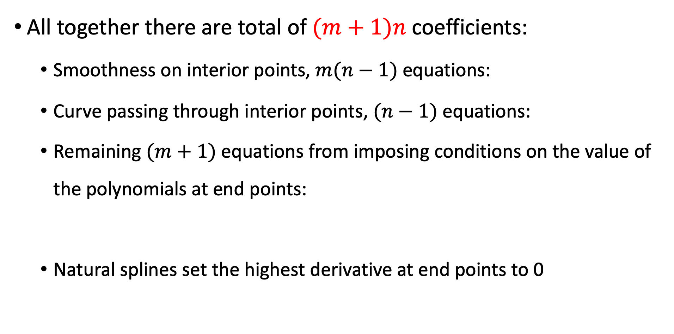

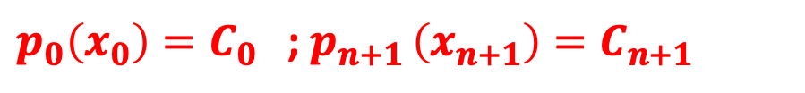


Splines: Determining the coefficients
All together there are total of $(m+1)n$ coefficients:
Smoothness on interior points, $m(n−1)$equations:
Curve passing through interior points, $(n−1)$equations:
Remaining $(m+1)$equations from imposing conditions on the value of the polynomials at end points:
Natural splines set the highest derivative at end points to 0
$$p_{i}^{\left(l\right)}\left(x_{i+1}\right)=p_{i+1}^{\left(l\right)}\left(x_{i+1}\right)$$
$$p_{i}\left(x_{i}\right)=f_{i}$$
$p_{0}\left(x_{0}\right)=C_{0}$ ; $p_{n+1 }\left(x_{n+1}\right)=C_{n+1}$
plus a choice of some derivatives:
$p_{0}^{(l)}\left(x_{0}\right)=C_{0}^{l}$ ; $p_{n+1}^{(l)}\left(x_{n+1}\right)=C_{n+1}^{l}$
Notes:
Natural splines sets that highest derivative to 0 at end points.

Slide 27
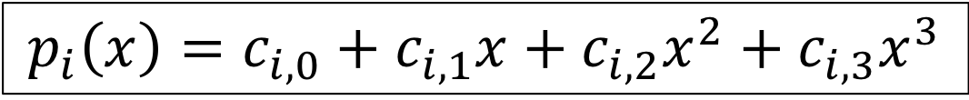
Most popular: Cubic splines, m = 3
$$p_{i}\left(x\right)=c_{i,0}+c_{i,1}x+c_{i,2}x^{2}+c_{i,3}x^{3}$$
Easy to implement
Produce a curve that appears to be seamless
Avoids distortions near the edges
Only piecewise continuous, third derivatives are discontinuous

Slide 28
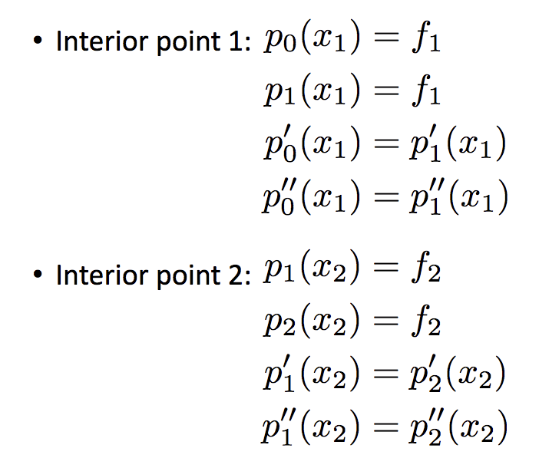
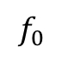
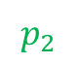
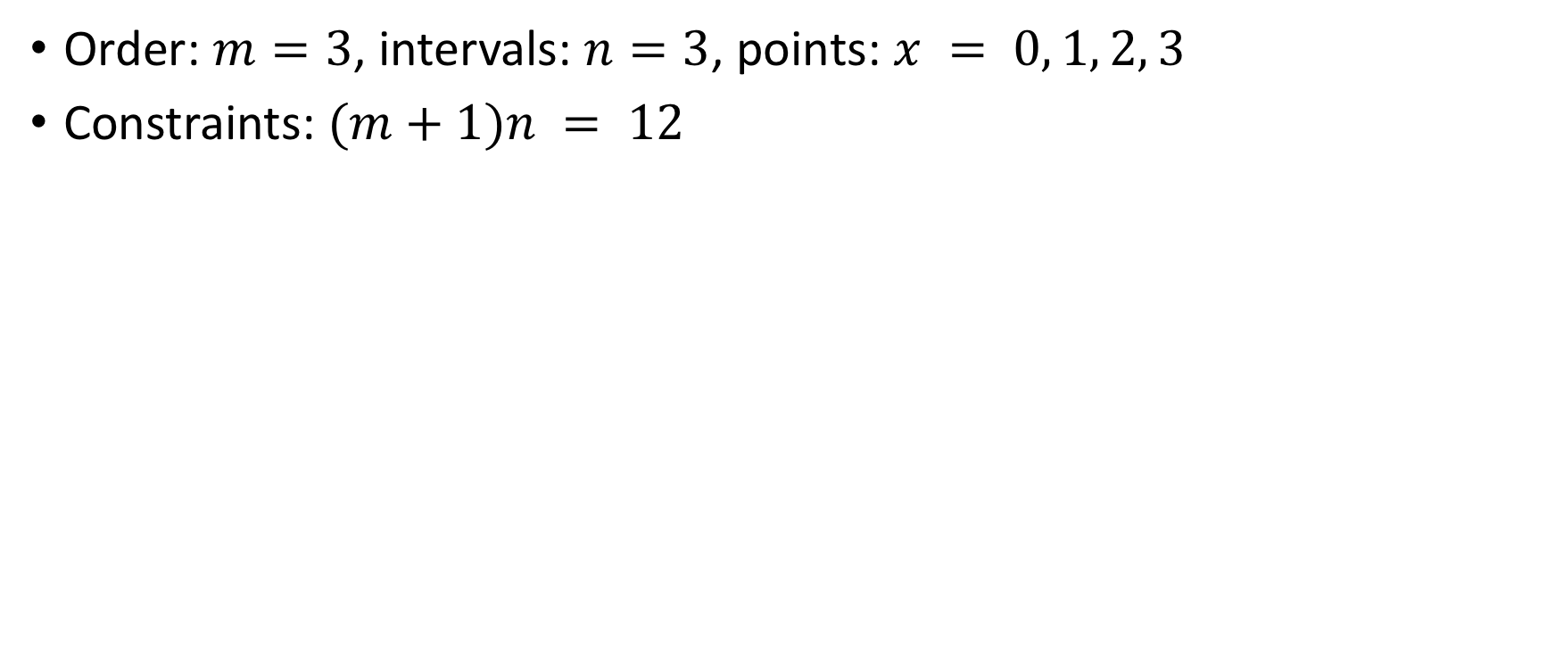
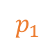
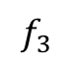

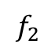
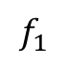
Cubic spline example: 3 intervals
Order: $m=3$, intervals: $n=3$, points: $x = 0, 1, 2, 3$
Constraints: $(m+1)n = 12$
$$f_{2}$$
$$p_{1}$$
$$p_{2}$$
$$f_{0}$$
$$p_{0}$$
$$f_{1}$$
$$f_{3}$$

Slide 29
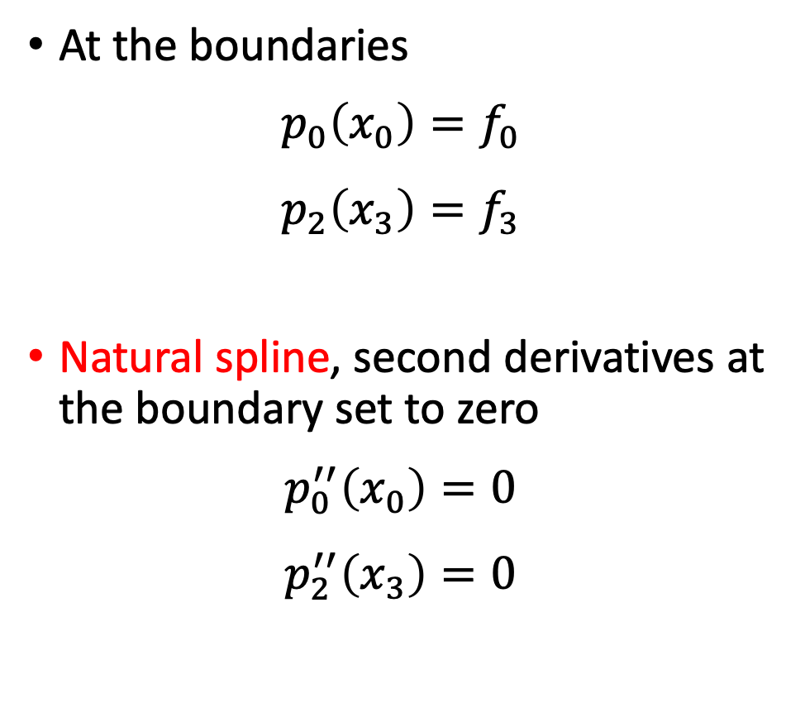
Cubic spline example: 3 intervals
At the boundaries
$$p_{0}\left(x_{0}\right)=f_{0}$$
$$p_{2}\left(x_{3}\right)=f_{3}$$
Natural spline, second derivatives at the boundary set to zero
$$p_{0}^{′′}\left(x_{0}\right)=0$$
$$p_{2}^{′′}\left(x_{3}\right)=0$$
$$f_{2}$$
$$p_{1}$$
$$p_{2}$$
$$f_{0}$$
$$p_{0}$$
$$f_{1}$$
$$f_{3}$$

Slide 30
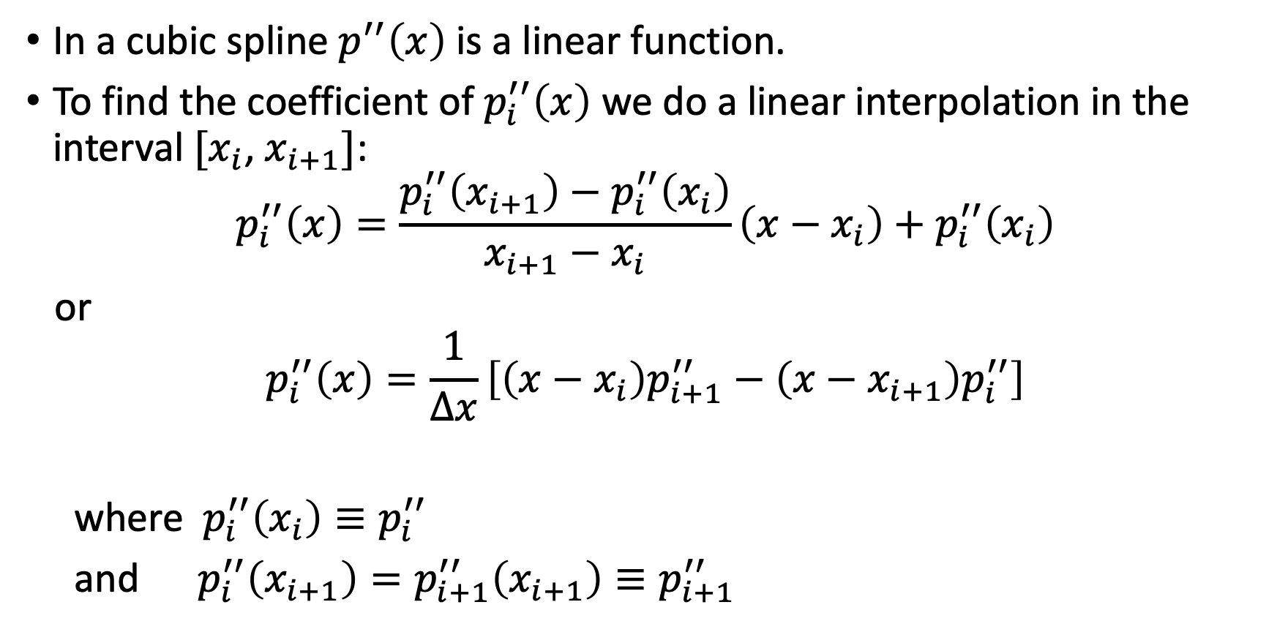
Now solve for the coefficients:
In a cubic spline $p^{′′}\left(x\right)$is a linear function.
To find the coefficient of $p_{i}^{′′}\left(x\right)$ we do a linear interpolation in the interval $[x_{i}$, $x_{i+1}]$:
$$p_{i}^{′′}\left(x\right)=\frac{p_{i}^{′′}\left(x_{i+1}\right)−p_{i}^{′′}\left(x_{i}\right)}{x_{i+1}−x_{i}}\left(x−x_{i}\right)+p_{i}^{′′}\left(x_{i}\right)$$
or
$$p_{i}^{′′}\left(x\right)=\frac{1}{Δx}\left[\left(x−x_{i}\right)p_{i+1}^{′′}−\left(x−x_{i+1}\right)p_{i}^{′′}\right]$$
where $p_{i}^{′′}\left(x_{i}\right)≡p_{i}^{′′}$
and $p_{i}^{′′}\left(x_{i+1}\right)=p_{i+1}^{′′}\left(x_{i+1}\right)≡p_{i+1}^{′′}$

Slide 31
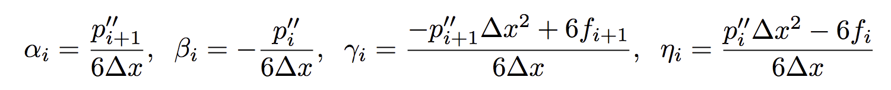
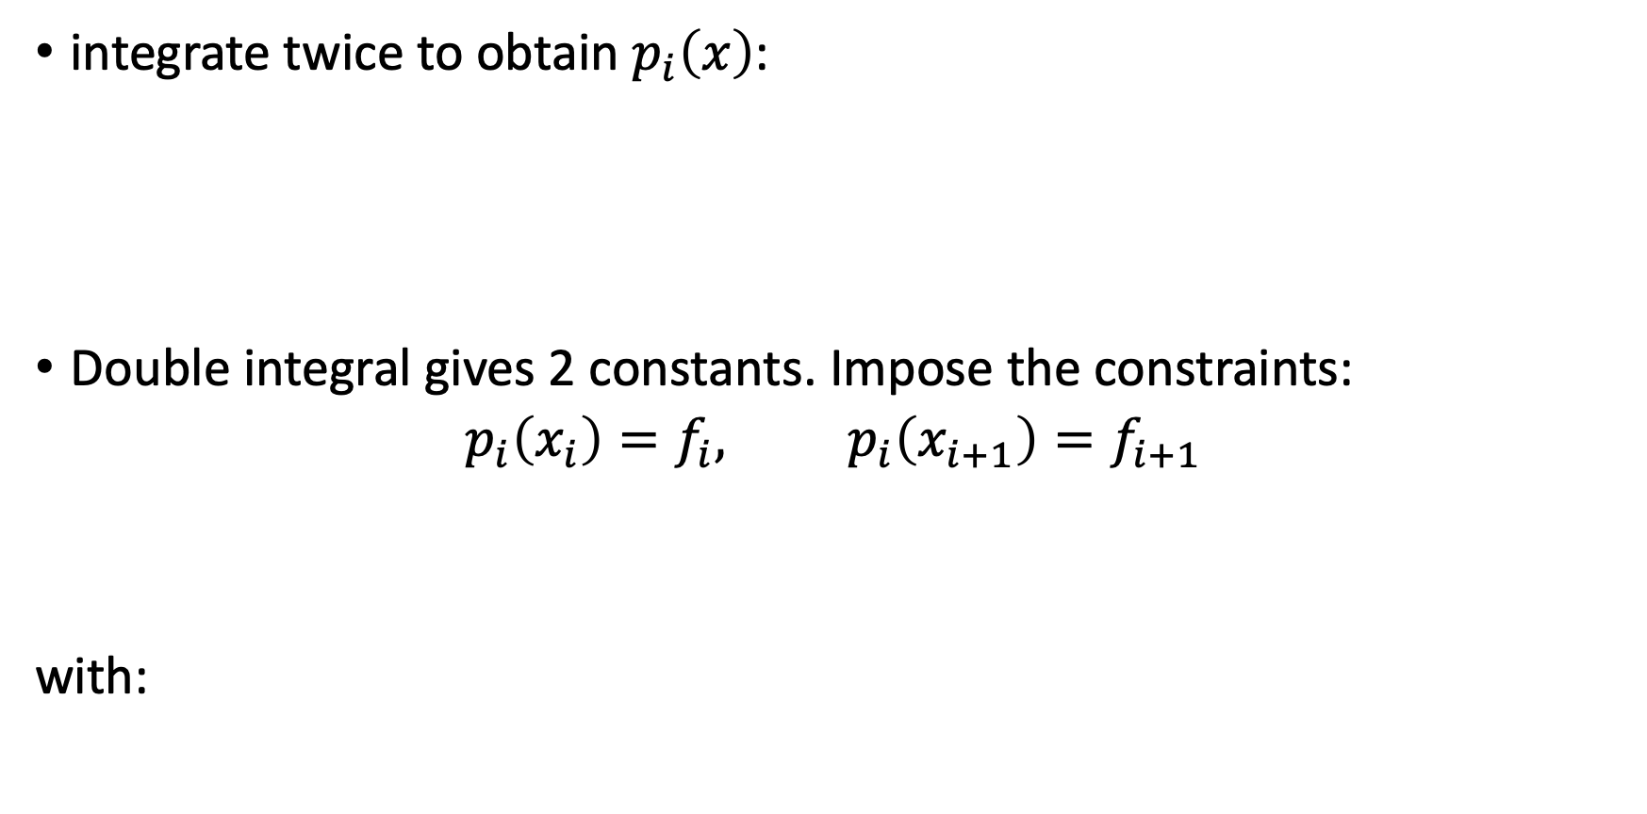
Now solve for the coefficients:
integrate twice to obtain $p_{i}\left(x\right)$:
Double integral gives 2 constants. Impose the constraints:
$$p_{i}\left(x_{i}\right)=f_{i}, p_{i}\left(x_{i+1}\right)=f_{i+1}$$
with:

Slide 32
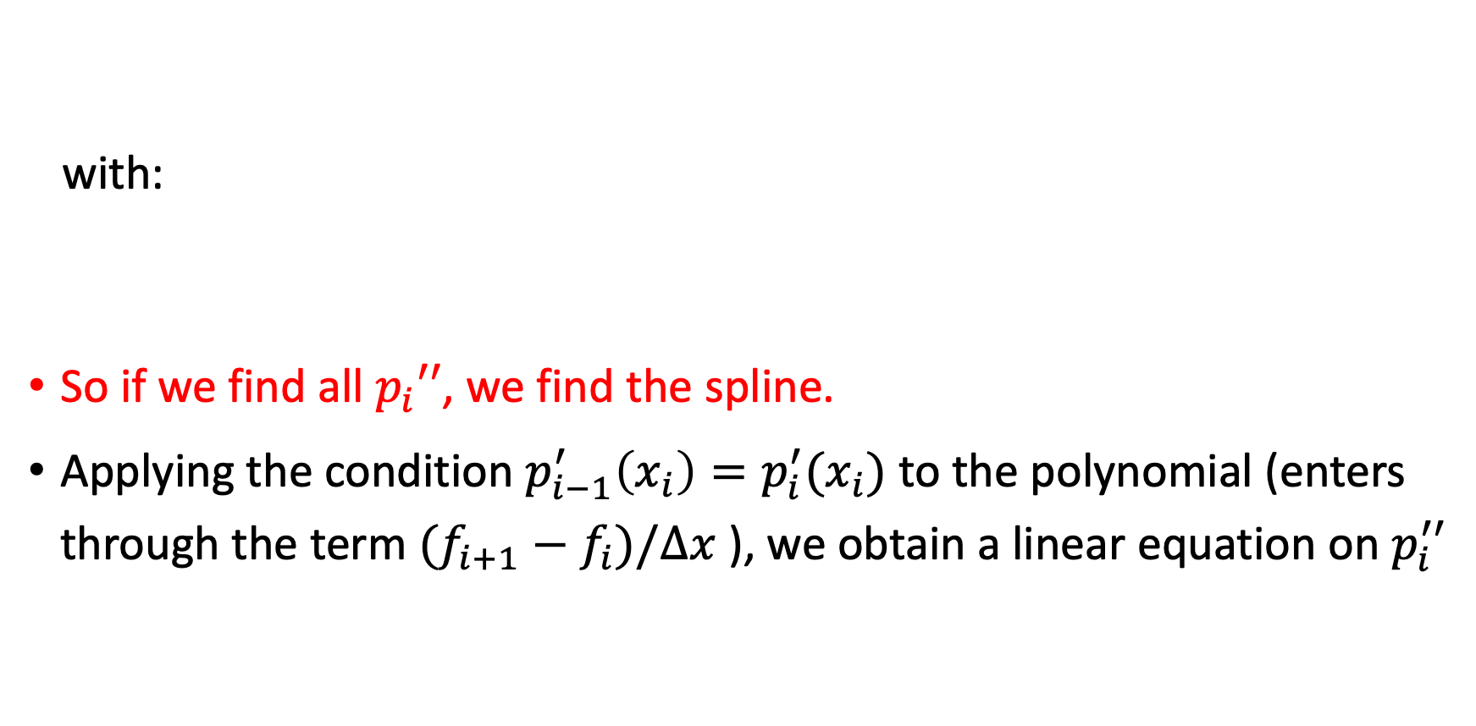
Now solve for the coefficients:
with:
So if we find all $p_{i}′′$, we find the spline.
Applying the condition $p_{i−1}^{′}\left(x_{i}\right)=p_{i}^{′}(x_{i})$ to the polynomial (enters through the term $(f_{i+1}−f_{i})/Δx$ ), we obtain a linear equation on $p_{i}^{′′}$

Slide 33
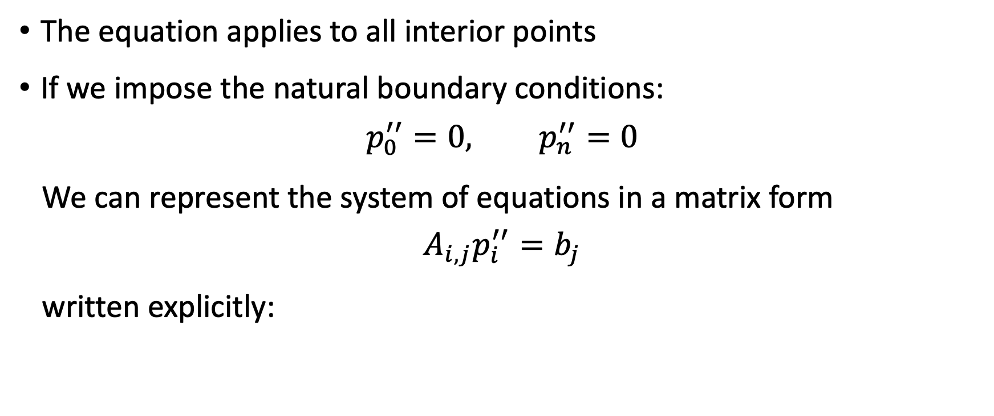
Now solve for the coefficients:
The equation applies to all interior points
If we impose the natural boundary conditions:
$$p_{0}^{′′}=0, p_{n}^{′′}=0$$
We can represent the system of equations in a matrix form
$$A_{i,j}p_{i}^{′′}=b_{j}$$
written explicitly:

Slide 34
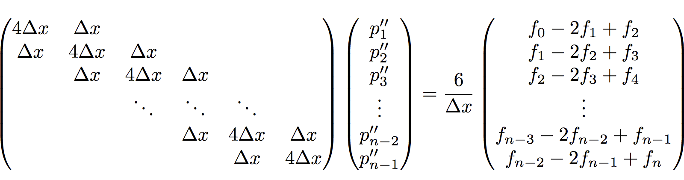
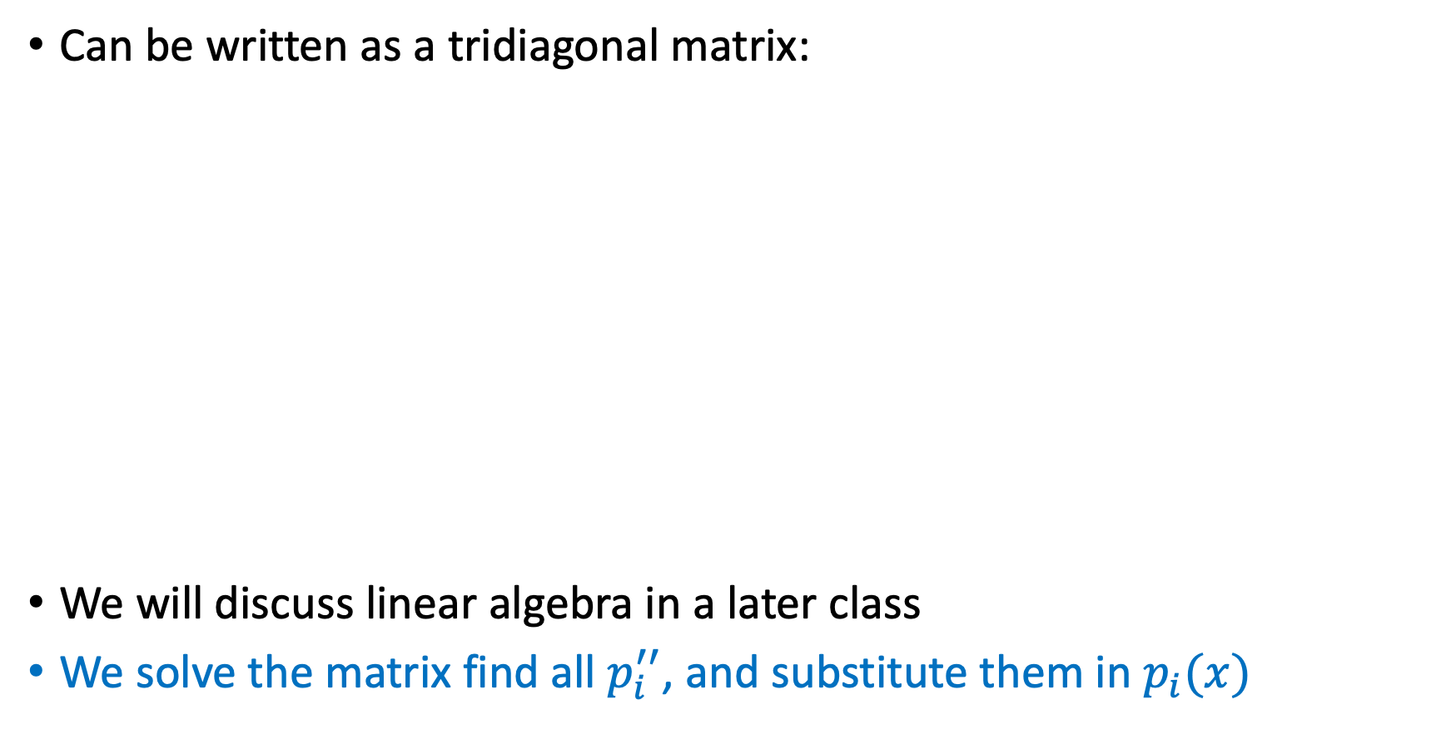
Results in a system of linear equations
Can be written as a tridiagonal matrix:
We will discuss linear algebra in a later class
We solve the matrix find all $p_{i}^{′′}$, and substitute them in $p_{i}(x)$

Slide 35
Example: Cubic spline for random numbers

Slide 36
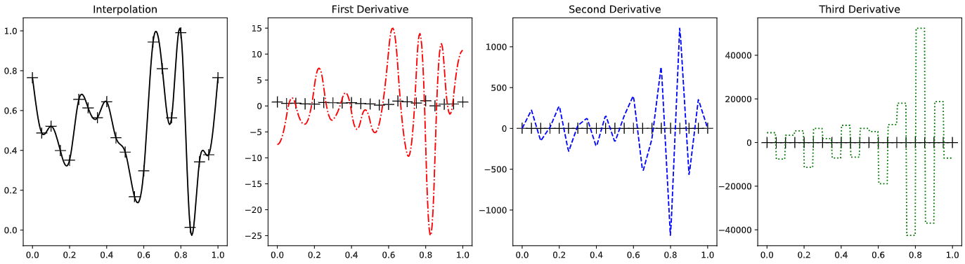
Example: Derivatives of cubic splines

Slide 37
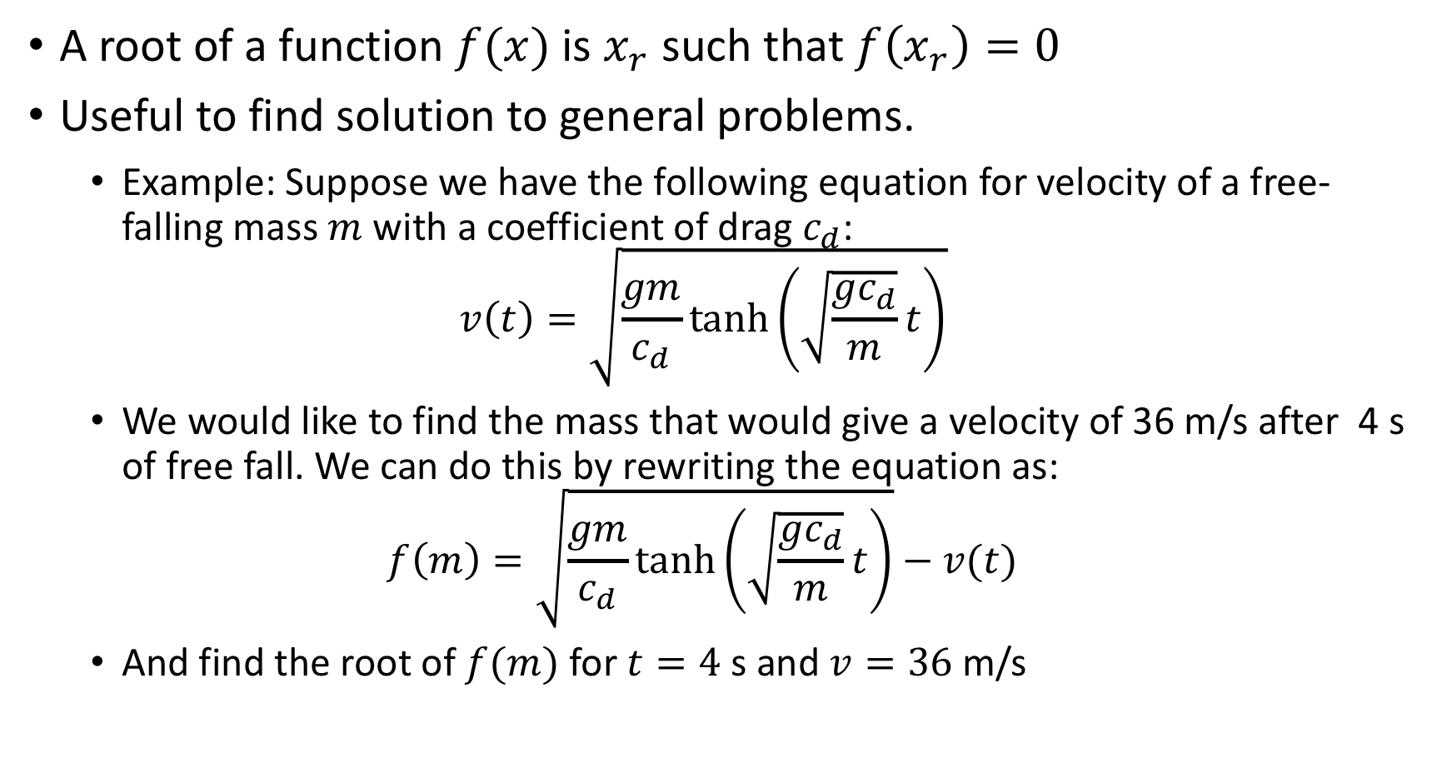
Finding roots of functions
A root of a function $f(x)$ is $x_{r}$ such that $f\left(x_{r}\right)=0$
Useful to find solution to general problems.
Example: Suppose we have the following equation for velocity of a free- falling mass $m$ with a coefficient of drag $c_{d}$:
$$v\left(t\right)=\sqrt{\frac{gm}{c_{d}}\tanh\left(\sqrt{\frac{gc_{d}}{m}}t\right)}$$
We would like to find the mass that would give a velocity of 36 m/s after 4 s of free fall. We can do this by rewriting the equation as:
$$f\left(m\right)=\sqrt{\frac{gm}{c_{d}}\tanh\left(\sqrt{\frac{gc_{d}}{m}}t\right)}−v(t)$$
And find the root of $f(m)$ for $t=4$s and $v=36$ m/s

Slide 38
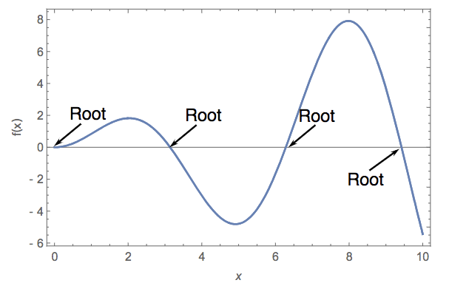
Finding roots of functions
For very simple functions, we can find the root analytically.
For more complicated functions, we must do this numerically.
3 methods
Bisection method
Newton Raphson method
Secant method
First rule: If possible plot the function to get an idea of where roots are

Slide 39
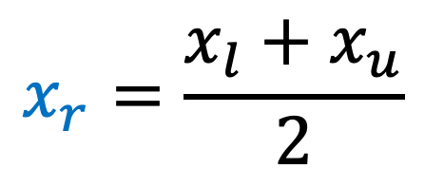
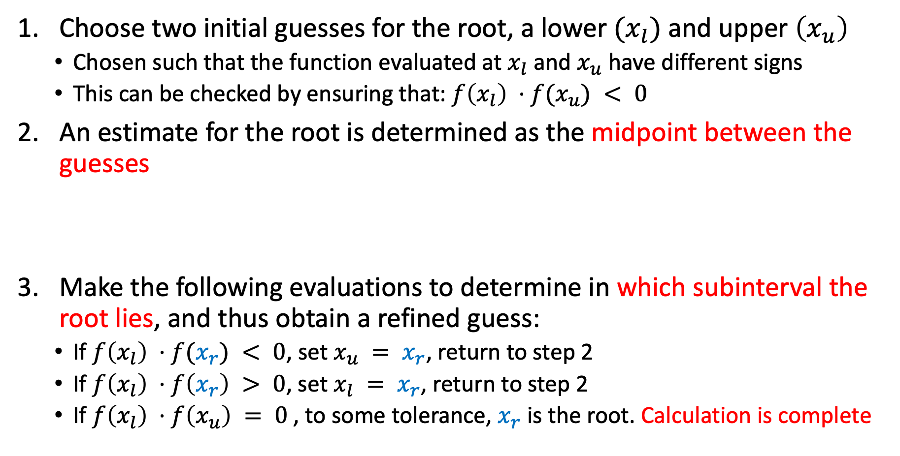
Bisection method
Choose two initial guesses for the root, a lower $(x_{l})$and upper $\left(x_{u}\right)$
Chosen such that the function evaluated at $x_{l}$ and $x_{u}$ have different signs
This can be checked by ensuring that: $f\left(x_{l}\right) ⋅f(x_{u}) < 0$
An estimate for the root is determined as the midpoint between the guesses
Make the following evaluations to determine in which subinterval the root lies, and thus obtain a refined guess:
If $f\left(x_{l}\right) ⋅f(x_{r}) < 0$, set $x_{u} = x_{r}$, return to step 2
If $f\left(x_{l}\right) ⋅f\left(x_{r}\right) > 0$, set $x_{l} = x_{r}$, return to step 2
If $f\left(x_{l}\right) ⋅f\left(x_{u}\right) = 0$, to some tolerance, $x_{r}$ is the root. Calculation is complete
$$x_{r}=\frac{x_{l}+x_{u}}{2}$$

Slide 40

Bisection method
https://youtu.be/zkd6CLfNNe8

Slide 41
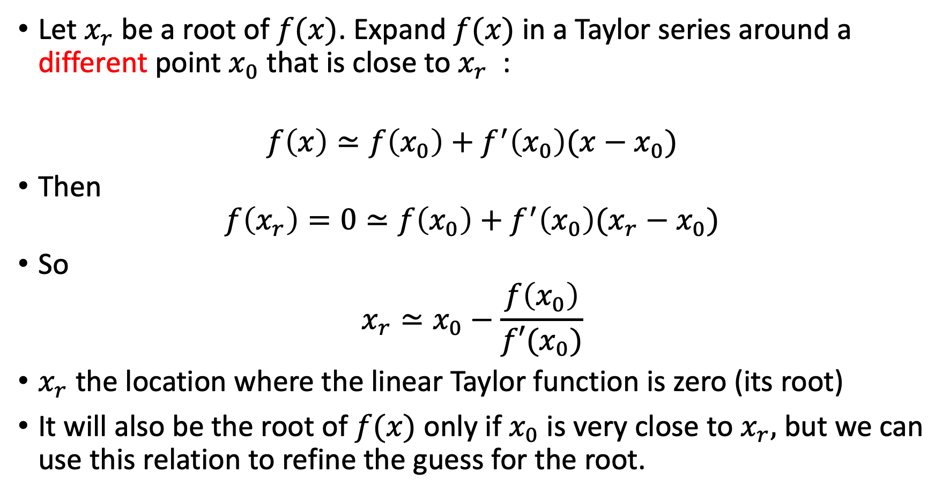
Newton-Raphson method
Let $x_{r}$be a root of $f(x)$. Expand $f(x)$ in a Taylor series around a different point $x_{0}$ that is close to $x_{r}$ :
$$f\left(x\right)≃f\left(x_{0}\right)+f^{′}\left(x_{0}\right)(x−x_{0})$$
Then
$$f\left(x_{r}\right)=0≃f\left(x_{0}\right)+f^{′}\left(x_{0}\right)(x_{r}−x_{0})$$
So
$$x_{r}≃x_{0}−\frac{f\left(x_{0}\right)}{f′(x_{0})}$$
$x_{r}$ the location where the linear Taylor function is zero (its root)
It will also be the root of $f(x)$ only if $x_{0}$ is very close to $x_{r},$ but we can use this relation to refine the guess for the root.

Slide 42
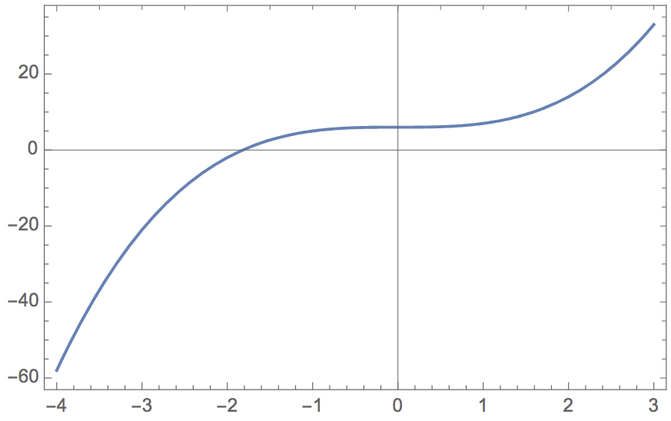
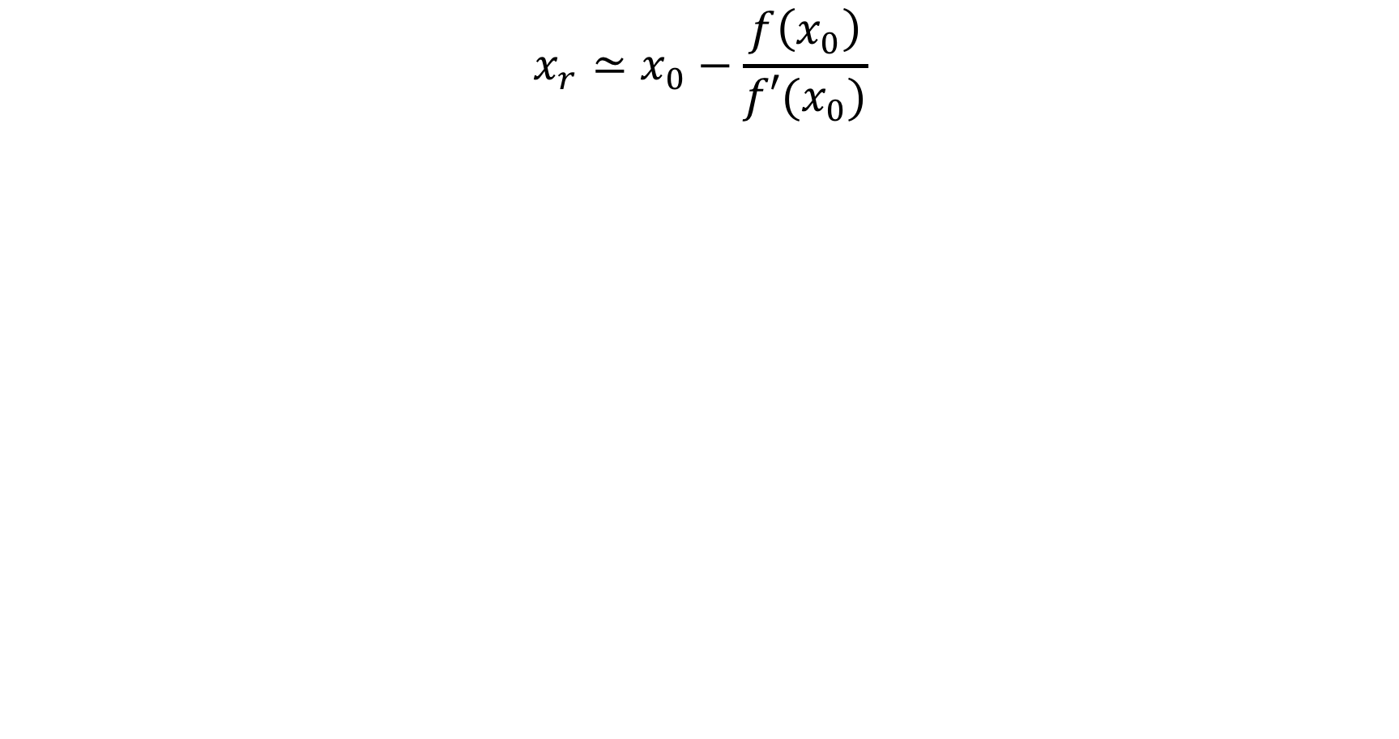


Newton-Raphson method
$$x_{r}≃x_{0}−\frac{f\left(x_{0}\right)}{f′(x_{0})}$$
$$x_{r}$$
$$x_{0}$$

Slide 43


Newton-Raphson method
$$x_{r}≃x_{0}−\frac{f\left(x_{0}\right)}{f′(x_{0})}$$
$$x_{0}−\frac{f\left(x_{0}\right)}{f′(x_{0})}$$
$${\tilde{x}}_{r}$$
$$x_{r}$$
$$x_{0}$$

Slide 44



Newton-Raphson method
$$x_{r}≃x_{0}−\frac{f\left(x_{0}\right)}{f′(x_{0})}$$
$${\tilde{x}}_{r}$$
$$x_{r}$$
$$x_{0}$$

Slide 45
Newton-Raphson method
$$x_{r}≃x_{0}−\frac{f\left(x_{0}\right)}{f′(x_{0})}$$
$${\tilde{x}}_{r}$$
$$x_{r}$$
$$x_{0}$$

Slide 46



Newton-Raphson method
$$x_{r}≃x_{0}−\frac{f\left(x_{0}\right)}{f′(x_{0})}$$
$$f\left(x_{0}\right)$$
$$x_{0}− {\tilde{x}}_{r}$$
$${\tilde{x}}_{r}$$
$$x_{0}$$
$$f^{′}\left(x_{0}\right)=\frac{f\left(x_{0}\right)}{{(x}_{0}−{\tilde{x}}_{r})}$$

Slide 47

Newton-Raphson method procedure
Make an initial guess for the root: $x_{0}$
Use the Taylor series expansion to find a better estimate of the root:
$$x_{1}≃x_{0}−\frac{f\left(x_{0}\right)}{f′(x_{0})}$$
Use $x_{1}$ as an improved estimate at the root and employ the Taylor series expansion again to get a better estimate $x_{2}$
Repeat process until the answer is accurate enough at the n’th estimate:
$$x_{n}≃x_{n−1}−\frac{f\left(x_{n−1}\right)}{f′(x_{n−1})}$$

Slide 48

Newton-Raphson method procedure

Slide 49

Newton-Raphson method
https://youtu.be/OgQNXe03lh4

Slide 50

Failure of Newton-Raphson
Example of a simple function that defeats Newton-Raphson Iteration:
Each estimate gets further from the true root. Estimates are diverging not converging

Slide 51
Careful in choosing the stopping criteria for iterations
Could stop when we reach some maximum number of iterations
Estimate may be no where near the root
We can consider this case a failure of the method and warn user about it.

Slide 52


Careful in choosing the stopping criteria for iterations
Could stop when we reach some maximum number of iterations
Estimate may be no where near the root
We can consider this case a failure of the method and warn user about it.
Could stop when the value of the function evaluated at the $n$’th estimate is less than a small number: $\left|f\left(x_{n}\right)\right|<ε$
Can be deceptive; final estimate may not be near a root, might just be close to zero

Slide 53


Careful in choosing the stopping criteria for iterations
Could stop when we reach some maximum number of iterations
Estimate may be no where near the root
We can consider this case a failure of the method and warn user about it.
Could stop when the value of the function evaluated at the $n$’th estimate is less than a small number: $\left|f\left(x_{n}\right)\right|<ε$
Can be deceptive; final estimate may not be near a root, might just be close to zero
Could stop when change between estimates becomes small relative to the current ($n′$th) estimate: $\left|x_{n+1}−x_{n}\right|<ε\left|x_{n}\right|$
Better, but still fails when the root is located at zero

Slide 54


Careful in choosing the stopping criteria for iterations
Could stop when we reach some maximum number of iterations
Estimate may be no where near the root
We can consider this case a failure of the method and warn user about it.
Could stop when the value of the function evaluated at the $n$’th estimate is less than a small number: $\left|f\left(x_{n}\right)\right|<ε$
Can be deceptive; final estimate may not be near a root, might just be close to zero
Could stop when change between estimates becomes small relative to the current ($n′$th) estimate: $\left|x_{n+1}−x_{n}\right|<ε\left|x_{n}\right|$
Better, but still fails when the root is located at zero, can never stop.
So let's use:
$$\left|x_{n+1}−x_{n}\right|<\left\{\begin{aligned}ε\left|x_{n}\right| , when \left|x_{n}\right|≠0 \\ ε , when \left|x_{n}\right|=0\end{aligned}\right.$$

Slide 55


Newton-Raphson method procedure
Make an initial guess for the root $x_{0}$, and the convergence tolerance $ε$
Loop through $n$ up to a maximum number $N_{max}$ (exit and tell the user that the root finding has failed if it reaches $N_{max}$)
Make sure $f’\left(x\right)≠ 0$.
Compute new estimate of root: $x_{n}≃x_{n−1}−\frac{f\left(x_{n−1}\right)}{f′(x_{n−1})}$
Check convergence criteria:
$$\left|x_{n+1}−x_{n}\right|<\left\{\begin{aligned}ε\left|x_{n}\right|, when \left|x_{n}\right|≠0 \\ ε , when \left|x_{n}\right|=0\end{aligned}\right.$$

Slide 56


Secant method
Similar to the Newton-Raphson method, but does not require calculating the derivative of the function
Start with two initial guesses, $x_{i−1}$ and $x_{i}$
Use a finite difference derivative to get a new guess $x_{i+1}$
$$x_{i+1}=x_{i}−f(x_{i})\frac{(x_{i−1}−x_{i}) }{f\left(x_{i−1}\right)−f(x_{i})}$$
Proceed in the same way as the Newton-Raphson method
For the next step use $x_{i+1}, x_{i}$ to calculate $x_{i+2}$…
$$\frac{1}{f′(x_{i−1/2})}$$

Slide 57




Secant method vs. Newton-Raphson method
$$\frac{f\left(x_{i−1}\right)−f(x_{i})}{(x_{i−1}−x_{i})}$$
$$f′(x_{i})$$
$x_{i−1}$
$$x_{i}$$

Slide 58
Summary of root-finding methods
Bisection:
Robust (with appropriate initial guesses)
Slow, each iteration reduces error by a factor of two
Need to make sure root is within initial guesses
Newton-Raphson:
Fast: often only takes a few iterations
Need to know the derivative of the function and it must exist
Can diverge, e.g., in cases with small second derivatives
Secant method
Similar convergence speed as Newton-Raphson method
Don’t need analytical derivatives
Same divergence properties as NR method
Numerical derivatives may be noisy

Slide 59
After class tasks
Homework 1 has been posted
Readings:
Pang Section 2.1 and 3.3
Wikipedia article on Chebyshev nodes
Myths about polynomial interpolation
Wikipedia page on root finding

